Slide 1
Classical Problems in Synchronization

Slide 2
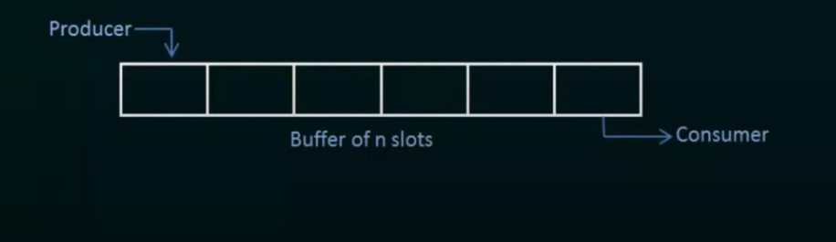
The bounded buffer problem
Producer Consumer Problem
There is a buffer of n slots and each slot is capable of storing one unit of data.
There are two processes running
Producer & Consumer – operating on the buffer

Slide 3
The bounded buffer problem
A producer tries to insert data into an empty slot of the buffer.
A consumer tries to remove data from a filled slot in the buffer.

Slide 4
The bounded buffer problem
A producer should not insert data when the buffer is full
Consumer should not remove data when the buffer is empty.
The producer and consumer should not insert and remove data simultaneously.

Slide 5
The bounded buffer problem
M (mutex) - a Binary semaphore which is used to acquire and release the lock.
Empty - a counting semaphore whose initial value is the number of slots in the buffer, since, initially all slots are empty.
Full - a counting semaphore whose initial value is 0. Number of filled slots.

Slide 6
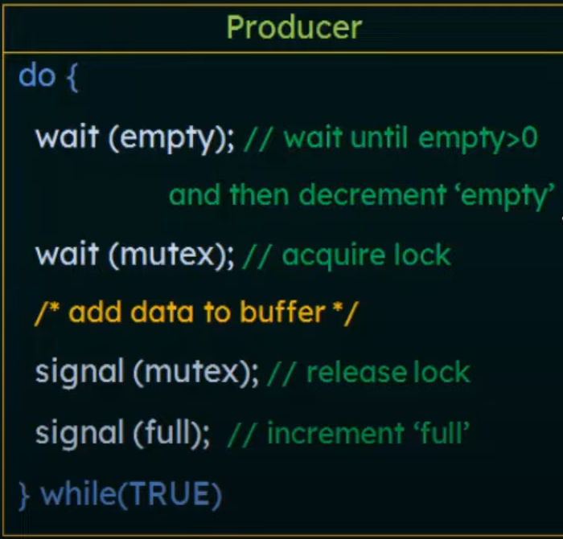
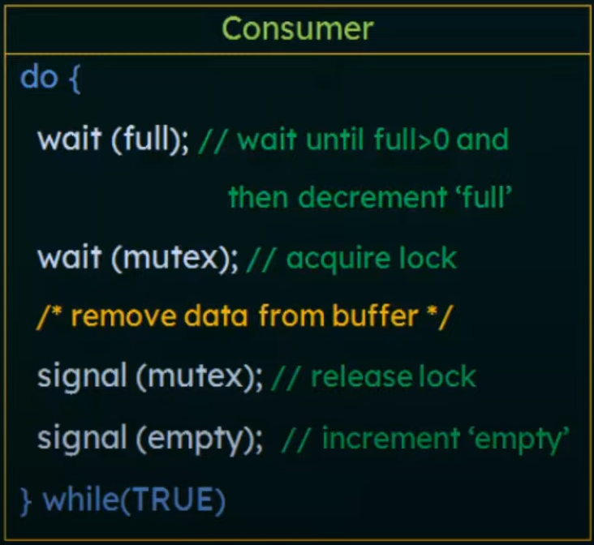
Producer & Consumer Operation

Slide 7
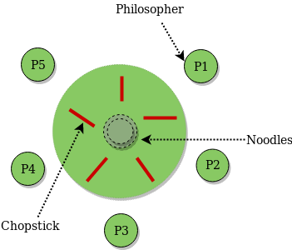
The Dining Philosophers Problem
Five philosophers sit around a circular table and alternate between thinking and eating.
A bowl of noodles and five forks for each philosopher are placed at the center of the table.

Slide 8
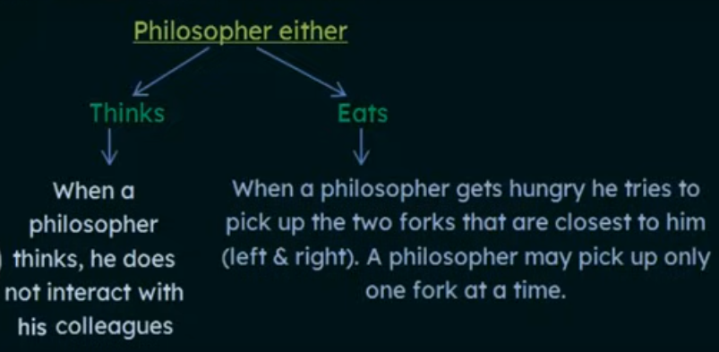
The Dining Philosophers Problem
One cannot pick up a fork that is already in the hand of a neighbor.
When a hungry philosopher has both his forks at same time, he eats without releasing his fork.
When he has finished eating, he puts down both of his forks and starts thinking again.

Slide 9
The Dining Philosophers Problem
A philosopher must use both their right and left forks to eat.
A philosopher can only eat if both of his or her immediate left and right forks are available.
If the philosopher's immediate left and right forks are not available, the philosopher places their (either left or right) forks on the table and resumes thinking.

Slide 10
Dining Philosophers – Resource Allocation Problem
Forks are limited
No two philosophers are allowed to eat simultaneously.
Problem of resource allocation in synchronized manner.
Philosophers → Processes
Fork → Resources required by the processes
Sharing Limited resources to processes

Slide 11
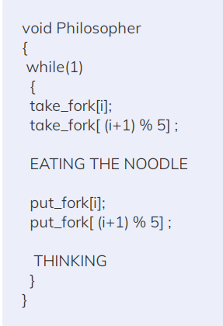

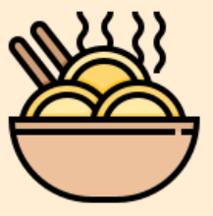

The Dining Philosophers Problem
P0
F1
F0
P1
P4
F2
F4
P2
P3
F3

Slide 12
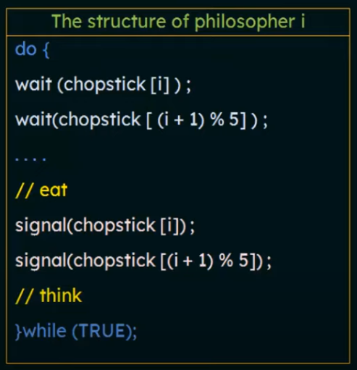
The Dining Philosophers Problem
P0
F1
F0
P1
P4
F2
F4
P2
P3
F3

Slide 13
Readers Writers Problem
Managing access to shared data by multiple threads or processes.
Two processes
Readers : Multiple readers can access the shared data simultaneously without causing any issues because they are only reading and not modifying the data.
Writers : Only one writer can access the shared data at a time to ensure data integrity, as writers modify the data, and concurrent modifications could lead to data corruption or inconsistencies.

Slide 14
Readers Writers Problem
Multiple Readers: A number of readers may access simultaneously if no writer is presently writing.
Exclusion for Writers: If one writer is writing, no other reader or writer may access the common resource.

Slide 15
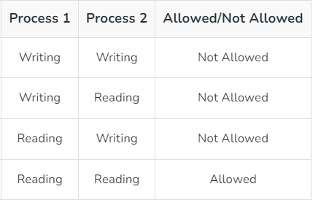
Readers Writers Problem
One set of data is shared among a number of processes
Once a writer is ready, it performs its write. Only one writer may write at a time
If a process is writing, no other process can read it
If at least one reader is reading, no other process can write
Readers may not write and only read

Slide 16
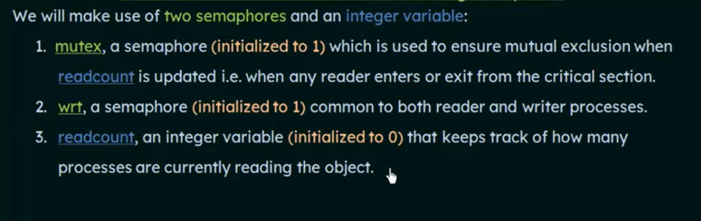
Readers Writers Problem

Slide 17
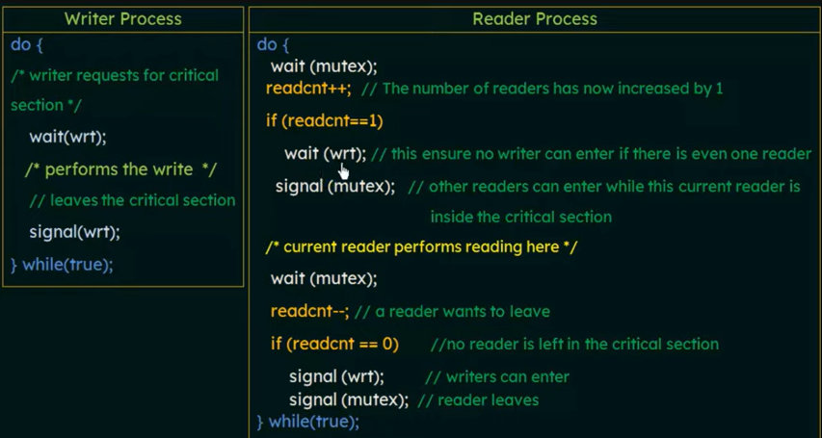
Readers Writers Problem

